Slide 1

Training-of-Trainers
Training-of-Trainers
Notes:
Materials:
Post-it notes
Highlighters
Flags
Index cards
Chart tablet
Chart markers
Bond paper
Sign in sheet

Slide 2
Objectives
  Content Objective – Participants will explore how to plan effective instruction that addresses the language development process of ELLs identified at the beginning and intermediate proficiency levels in grade 3 or higher.
  Language Objective – Participants will discuss how to design instruction to provide an intensive and ongoing foundation in second language acquisition.
Notes:
Read training goals with participants to model the practice of having objectives reviewed with students prior to a lesson or instruction.
Content objectives describe what content will be learned, while Language objectives describe how the content will be learned.

Slide 3

Navigating the ELPS Instructional Tool
*Open the tool and read p.5.
Discuss with a partner why this tool can help you target students who are identified as beginning, and intermediate.
Notes:
This tool will be your framework to guide your instruction. It will help you create a supportive environment to help ELLs be successful in the classroom.

Slide 4

What Will You Use to Craft Your Lesson?
TEKS
ELPS
Assessment results
Student data
ELPS Instructional Tool
How I am going to do it?
Notes:
This tool is designed for general education teachers. It is a resource for teachers to help them guide their instruction.
Ask: What will you use to craft your lesson?–The TEKS.
It will answer their question: How I am going to do it? –Through the ELPS. It will help you create a supportive environment to help ELLs be successful in the classroom.

Slide 5

ELPS Instructional Tool
  Meeting the Linguistic Needs of
  Beginning and Intermediate ELLs:
    Language Development Process
    ELPS-TELPAS Proficiency Level
    Descriptors (PLDs).
    Degree of Linguistic Accommodations by Language Domain.
    Linguistic Processing Skills (receptive, productive).
p. 1
Notes:
These are the main things we will be talking about:
The purpose of this tool is to support and outline how to plan focused, targeted, and systematic instruction to meet the linguistic needs of ELLs identified at the beginning and intermediate proficiency levels in grade 3 or higher as well as explore the language development process.
We will speak about:
1.The receptive skills vs. the productive skills.
2.The degrees of linguistic accommodations (some students need certain support, others do not need it).
Processing Activity: Refer to the Table of Contents on p.7 and have participants engage in a picture walk or tab particular sections of the tool to ensure participants are familiar with the format and/or layout.
Say: Open and skim through the tool. See how each section can be used. You can use its content as needed but it is not a comprehensive tool to deliver instruction.

Slide 6

ELPS in Review
Statutory Requirement
19 Texas Administrative Code, §74.4
Curriculum Requirements
Subchapter A. Required Curriculum
§74.4 English Language Proficiency Standards
p. 6
Notes:
Chapter 74.4-This tool really focuses in this statute.
Trainer will explain how the ELPS are divided.
Let participants read p.6 of the ELPS Instructional Tool, give them time to read silently. Then do choral reading of text on p.6 of the tool.

Slide 7
ELPS Framework… Do You Know What Should Be in Each Quadrant?
A. Introduction | B. School District Responsibilities
Cross-Curricular Second Language Acquisition Knowledge and Skills (SE) | D. Proficiency Level Descriptors
Work with a partner. Add notes and complete the organizer
§74.4 ELPS.
Notes:
The handout for this activity is on the last slide of this PowerPoint. Copy and print to conduct the activity. Ask participants if they know what each quadrant addresses. Ask for somebody to explain what each quadrant addresses.
After that the presenter will review/teach each quadrant separately.
A. The ELPS Big Ideas
Linguistically accommodated instruction
Develop listening, speaking, reading and writing in English
Language proficiency levels-beginning, intermediate, advanced, advanced high
B. District Responsibilities:
Make content comprehensible
Build academic language
Curriculum –content instruction in English must be…
Communicated
Sequenced
Scaffolded
For Grades 3rd-12th Focused, Targeted, and Systematic language instruction for Beginning and Intermediate.
C. Student Expectations:
Learning strategies
Listening
Speaking
Reading
Writing
D. Based on Proficiency Level Descriptors:
Beginning
Intermediate
Advanced
Advanced High

Slide 8
ELPS… a Framework
A. Big Ideas
Make content comprehensible
Build academic language
B. Big Responsibilities
Communicated - TEKS
Sequenced - instruction
Scaffolded - support that leads to independence
C. Student Expectations
Learning strategies
Listening
Speaking
Reading
Writing
D. Language Levels (PLD’s)
Beginning (L,S,R.W)
Intermediate (L,S,R.W)
Advanced (L,S,R.W)
Advanced High (L,S,R.W)
Notes:
Highlight or Mention:
There are 4 main section to the ELPS: Big Ideas, Big Responsibilities, Student Expectations, and Language Levels.
Processing Activity:
First: Presenter will teach only the titles of each quadrant using hands motions.
Second: Presenter will add the information of each quadrant and will model how to remember the content.
Say: You will now use your body as a graphic organize to remember the main sections. Practice with the graphic organizer as a group, then with a partner:
1. Big ideas – right eye
2. Big responsibilities – left eye
3. Student expectations – right hand/5 fingers
4. Language levels – left hand/5 fingers
Provide a graphic organizer for participants to complete each quadrant.

Slide 9

High Five
Mingle around the room.
Find a partner and “high five” with him/her.
Discuss what the ELPS mean according to the Texas Administrative Code (Statute 74.4).
Discuss what they mean to you according to your responsibilities as a teacher of ELLs.
Share with the group.
How are we addressing the needs of ELLS at my campus? What are we doing to instruct them?
Notes:
Processing Activity: "High Five”.
Presenter: Go find a partner, “High five” with him/her. Have a discussion of what the ELPS mean, and what they mean to you, then share with the group what you discussed.
Presenter: The purpose of this activity is to see if we are addressing the needs of ELL's as we understand it, to reflect and think and ask yourself:
"How are we addressing the needs of ELL's students at my campus?”,
"What are we doing to instruct them?”
This is a tool that you need to share with your co-workers. It is for all educators.

Slide 10
§74.4 ELPS (a) Introduction
We are...
ELPS part of required curriculum
ELL need to know social and academic language
Integrate second language acquisition with content area instruction for all language skills
ELL must read, write, listen and speak with increasing complexity
ELPS SE apply K-12
Level descriptors serve as a road map
Notes:
This is what the ELPS mean as required by the state.

Slide 11
§74.4 ELPS (b) (1) to (b) (3)
School Districts Shall…
Identify students language proficiency levels.
Provide instruction of the foundation and enrichment curriculum according to the student’s English language proficiency.
Provide content-based instruction based on ELPS standards in a manner that is linguistically accommodated.
p. 9
Notes:
Refer participants to p. 9 of the ELPS Instructional Tool.
Say: Here you can find examples of what focused, targeted, and systematic look like. (Give participants time to read p. 9).
Now, think of these examples as things you can do to help ELLs move one level of English proficiency each year. This is a good piece to reflect of how we are ensuring that content is focused, targeted and systematic.
Language proficiency levels in English must be identified for listening, speaking, reading and writing. Without appropriate linguistically accommodated instructional activities, ELLs struggle to develop English language skills and content attainment.
(For last bullet) Second language acquisition instruction must be:
Focused: instruction centered on student acquisition of vocabulary, grammar, syntax and English mechanics necessary to support content-based instruction and accelerated learning of English (especially at the secondary level).
Targeted: specific goals and objectives align with vocabulary, grammar, syntax etc. Content objectives for ELLs align with TEKS-Language objectives align with ELPS.
Systematic: well organized structure in place to ensure students acquire structure of language. Comprehensive plan for students in grades 3-12 at beginner or intermediate level.

Slide 12


Talking Chips
Each person will take a chip (marker).
If you want to talk, place your marker in the center of the table.
You can not talk again until everyone has placed his/her marker in the center of the table
Once all the markers have been used you can retrieve your marker and any one can talk again

Slide 13
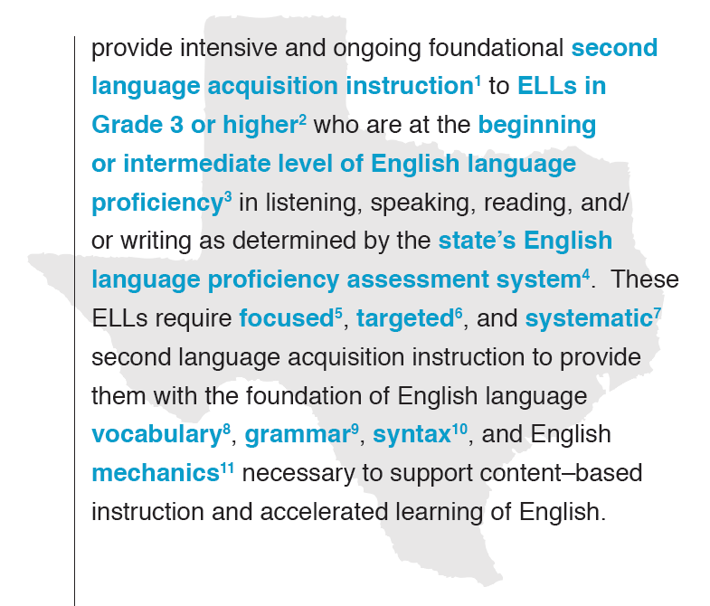

TAC, Chapter 74.4 (b)(4) school districts shall…
Talking Chips: each person has a marker use it to define one the highlighted terminology. In your own words!
Open the Tool, read p. 6 after all the words are defined,
p. 6
Notes:
Tell participants to close the Instructional tool, then to work with a partner and take turns defining the highlighted terminology.
Refer participants to the top section of p.6 of the ELPS Instructional Tool AFTER they give definitions in they own words.
Processing Activity:
Have participants engage in a word definition scan in order to review and clarify meanings. (They will scan the tool AFTER they define in their own words!)
Explain how the ELPS are the second language acquisition curriculum necessary for the success of ELLs. More specifically- Ch. 74.4 (b)(4) requires that school districts…, refer to slide and remind participants to keep this in the forefront in regards to this tool.

Slide 14

Word/Definition Matching Game
Get a set of cards (at your table).
With your ELPS Instructional Tool closed.
Match the words to the corresponding definition or statement.
Objective: To understand TAC, Chapter 74.4 (b) (4).
Use your Tool, p. 7 to check your answers
p. 7
Notes:
Materials:
ELPS Instructional Tool-Cards
ELPS Instructional Tool booklet
Print the ELPS Instructional Tool-Cards in color (use index paper). Cut them and place them in bags.
Presenter will prepare one set of cards per table.
Processing Activity: Time frame-3-4 min.
Say:
Get an envelope that contains a set of cards (on your table).
With your ELPS Instructional Tool closed,
Match the words to the corresponding definition or statement.
Use your ELPS Instructional tool, p. 7 to check your answers
Objective: To understand TAC, Chapter 74.4 (b) (4)

Slide 15

Second Language Acquisition
What is second language acquisition?
What are receptive skills?
What are expressive skills?
Read silently p. 8. Reflect.
p. 8
Notes:
Language domains can be divided into two categories:
Receptive is listening and reading (input).
Expressive is speaking and writing (output).
Refer participants to p.8 of the Tool

Slide 16

Paraphrase Passport
In groups, one of your members' will discuss what Receptive Skills are (p.8)
Another person must correctly paraphrase that statement, a third person will give feedback with regard to the completeness and accuracy of the paraphrase.
A fourth person will discuss the “Expressive Skills”, a fifth person will paraphrase
Any member can help giving cues or feedback.

Slide 17

Second Language Acquisition
Let’s discuss the content of p. 8. Why is it important to remember that second language acquisition is an interdependent process?
What is second language acquisition?
What are receptive skills?
What are expressive skills?
Share with our whole group.
p. 8
Notes:
Language domains can be divided into two categories:
Receptive is listening and reading (input).
Expressive is speaking and writing (output).
Refer participants to p.8 of the Tool
Second language acquisition is a process of learning a second language or target language and it is an interdependent process.
Say: As teachers we must support ELL students develop their CALP, their expressive skills. In order to do this you should ask yourself:
How often are my students speaking in my classroom?
Am I the only one speaking most of the time in my classroom?

Slide 18
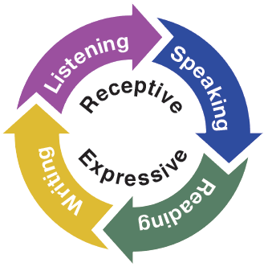
Second Language Acquisition
Progression of skills in the four language domains.
Receptive skills are necessary for comprehension and attainment of language.
Expressive skills are needed to express and share ideas.
p. 8
Notes:
As teachers we are supporting ELLS develop their CALP, their expressive skills.
Remind participants that Texas educators must provide intensive and ongoing foundational second language acquisition instruction to beginning and intermediate ELLs in grades 3 or higher in order to support content-based instruction and the accelerated learning of English.

Slide 19
Second Language Acquisition in the Classroom
Instructional tasks must implement a multitude of learning interactions promoting the development of receptive and expressive skills simultaneously.
In your group, discuss and tell what you use to develop student’s receptive skills and expressive skills.
Share with the whole group.
p. 8
Notes:
Make groups of 4 people. Refer participants to p.8 of the Tool.
Say: Based what you read on page 8, add/tell what you use to develop student’s Receptive skills and expressive skills. Then, share with our whole group.
We must ensure that ELL students develop their receptive and expressive skills. Thus, we need to ensure that the routines, activities and strategies we use are age appropriate, grade appropriate AND language proficiency appropriate.

Slide 20
Second Language Acquisition
Focused | Targeted | Systematic
Instruction and academic tasks are specifically designed with an emphasis on promoting students’ English language development. | Instruction and academic tasks are purposefully aligned to the language proficiency levels of ELLs. | Instruction and academic tasks are carefully planned and consistently implemented to address the progression of skills necessary to support the accelerated learning of English.
What does this look like and how does it sound in the classroom? This = teacher behavior
p. 9
Notes:
Refer participants back to p. 9 of the Tool.
Refer to slide for the definitions of focused, targeted, systematic.
Remind participants that beginning and intermediate level of English language proficiency in ELLs require focused, targeted, and systematic second language acquisition instruction to provide them with the foundation of English language vocabulary, grammar, syntax, and English mechanics necessary to support content-based instruction and accelerated learning of English.
Pose the question, what does this look like and how does this sound in the classroom? Have participants view the Teacher Tips for Beginning and Intermediate ELLS on pp. 22-25 of the Tool to keep in mind while planning instructional activities that support English development and content attainment.
Give participants time to answer the question within their group.

Slide 21

Timed Turns: How Are the ELPS Implemented?
No one can talk for more than a minute. Have a Timekeeper on each group.
Take turns sharing. How do you include linguistic accommodations in the design and delivery of content-based instruction? (routines, activities, and strategies to develop ELL’s receptive and expressive skills).
Volunteers share with our whole group
How often? Examples on p. 9
Notes:
Ask: How are the ELPS implemented? Some teachers may say: "I include them, I write the ELPS on my lesson". But sometimes they do not know what that should look like.
It is not easy to integrate them, so there is a need to explain that to teachers with clear examples. Direct teachers to p.9 of the Tool and ask them to identify and share:
One example of a Focused instructional activity or materials
One example of a Targeted instructional activity or materials
One example of Systematic instructional activity or procedure
Say:
“How often are you using the ELPS?” “What do you do if you are not an ESL, or a language arts teacher?”
“The importance of implementing the ELPS is that there needs to be a clear connection between the Academic content and the ELPS.” “Waiting for the TELPAS Assessment results will be too late to make linguistic accommodations.” “Observe your students.” “Teachers should integrate the ELPS into all instruction.”
Give thinking time for participants answer. (Teachers should provide ideas to implement them such as Sentence Starters, graphic organizers, etc.).

Slide 22
Count-Off 1 to 4
Go to p.9 of your ELPS Instructional Tool and read on your own the section titled: “Foundations of English Language.”
Continue taking turns and timing the speakers
You will discuss each of the four bulleted statements that will be shown on the next slide.
You will discuss how the information can help teachers support ELLs English language development and TEKS based content comprehension.
p.9
Notes:
Have participants form groups of four and each person will pick one of the bullets under the title “Foundations of English Language”
Each group member will pick one of the bulleted statements that will appear on the next slide. Time frame for this activity: 4 min.
Each person will pick one of the bullets to discuss how this information can help them assist with ELLs’ development of language and TEKS based content comprehension.

Slide 23
Foundations of English Language Acquisition
Understand student’s language proficiency levels to linguistically accommodate academic and essential vocabulary.
Allow students to practice oral and written forms of grammar and syntax during cooperative and independent tasks.
Provide students with a linguistic platform to build on in order to advance to the next proficiency level.
Include elements of the four language domains during content-based instruction.
How do these assist with English language development and content comprehension?
p.9
Notes:
Time Frame: 4 min.
Refer participants to p.9 of the Tool. Tell them to read on their own,
Processing Activity: Have participants form groups of four and each person will pick one of the bullets to discuss how it will assist with ELLs’ development of language and TEKS based content comprehension.
The Foundations of English Language:
Emphasize that the foundation of the English language is necessary for ELLs’ development and attainment of TEKS based content. Thus, teachers should plan instructional activities that allow students to practice oral and written forms of grammar and syntax during cooperative and independent tasks. If students lack the foundation of English Language, they will struggle to understand the content.
As educators, we need to ensure that the routines, activities, and strategies we use are age appropriate, and language proficiency appropriate.

Slide 24




§74.4 ELPS (c) Cross-Curricular Student Expectations
Learning Strategies
science
math
electives
listening
speaking
ELA
social studies
reading
writing
Division of Instructional Support
Notes:
Teach the foundations of English Language to develop and attain content knowledge.
The foundations of English language must be incorporated with Content Student Expectations of TEKS
To summarize the cross curricular second language acquisition knowledge and skills.
Teachers need to incorporated the English Language Proficiency Standards to their TEKS content and enrichment instruction, so how do they do this task? Most importantly, why? We are accountable for every ELL to learn English.

Slide 25


ELPS Integration Plan
Provide comprehensible input
Increase verbal interaction
Contextualize language
Reduce the anxiety
Active involvement
Notes:
Provide comprehensible input
Increase verbal interaction
Contextualize language
Reduce the anxiety
Active involvement

Slide 26

Language Development Process Includes…
PLDs
Linguistic Accommodations
Language Development Activities
Supplementary Activities
Progress Monitoring
pp 10-11
Notes:
Language development planning and content-based instruction involve an ongoing process in which teachers of ELLs must identify and respond to the linguistic and academic needs of individual ELLs.
Say: The language development process includes the PLDs, linguistic accommodations, language development activities, supplemental activities and progress monitoring. We will discuss what happens in each step on the next slide.

Slide 27
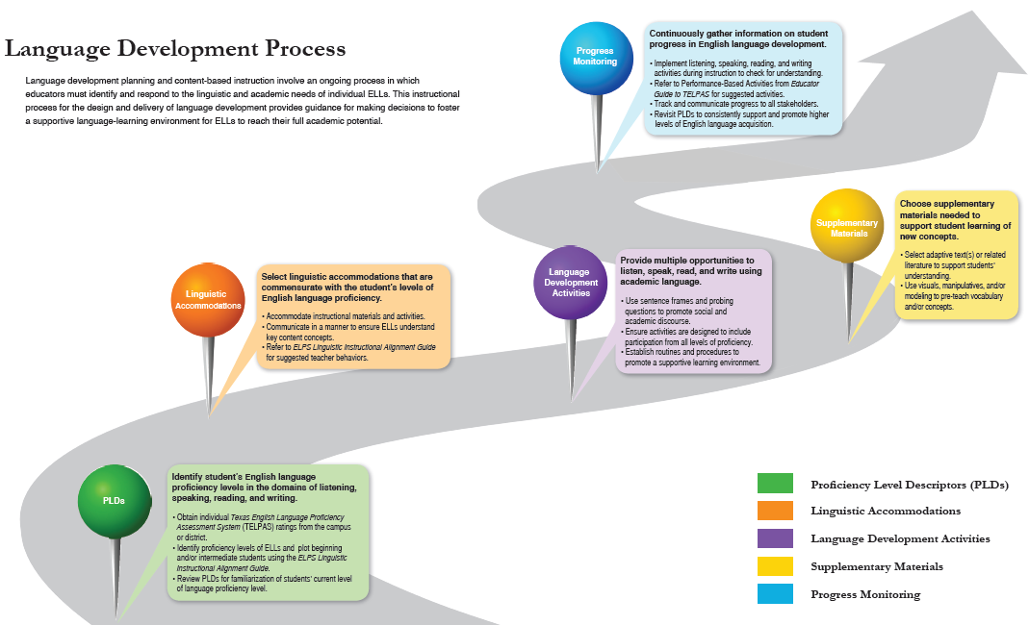
Read silently, reflect
pp. 10-11
Notes:
Refer participants to pp. 10-11 of the Tool
Review each step of the instructional process for the design and delivery of language development
Each pin has a corresponding color coded box with bulleted statements on how to accomplish the PLDs.
Provides guidance for making decisions to foster a supportive language-learning environment for ELLs to reach their full linguistic and academic potential.
Each person in the group will read silently to internalize the information. Participants will reflect and discuss with their group, the system that is in place at their campus, or district to support instruction that meets the linguistic needs of ELLs.
After that, each group member will share out with the rest of his/her group.
This activity will ensure that everyone understands each step in the language development process, so that they include them in their instruction.

Slide 28

Dice Processing Activity
Work in pairs or in groups of 4. Take turns rolling the dice, which ever term it lands on, that person will use that term to complete a question stem(s).
Plug the Language Development Process term in the blank space and read the complete sentence to your group.
Have group conversations to agree, disagree or add to the response.
Take turns until all the terms have been used to complete the question stems.
Notes:
Activity:
Work in pairs or in groups of 4.
Each participant will take a turn rolling the dice.
Roll the dice, which ever term it lands on, that person will use that term to complete a question stem(s).
Plug the Language Development Process term in the blank space and read the complete sentence to your group.
The group will have conversations to agree, disagree or add to the response.
Continue taking turns until all the terms have been used to complete the question stems.
Ask: “So what were the conversations?” Participants share their responses.

Slide 29

Language Development Process
How do/does ____ move ELLs toward the attainment of English language proficiency?
What is the effect on ELLs’ progress if___ is/are not addressed?
What is the relationship between the performance of ELLs and _____?
How is the English langue proficiency of ELLs affected when _____is/are not addressed?
Dice Activity
p.12
Notes:
Copy “Dice template”, cut and create the dices.
Use p. 12 of the Tool for this activity
Explain: These questions are intended to generate a reflective discourse regarding the language development process emphasizing the progress, performance, and attainment of the English language for ELLs.
Say: You will practice inserting in these sentence stems each of the 5 steps that appear on the pins.
Processing Activity:
Have participants work in pairs or in groups of 4.
Each participant will take a turn rolling the dice.
Roll the dice, which ever term it lands on, that person will use that term to complete a question stem(s).
Plug the Language Development Process term in the blank space and read the complete sentence to your group.
The group will have conversations to agree, disagree or add to the response.
Continue taking turns until all the terms have been used to complete the question stems.
Ask: “So what were the conversations?” Participants share their responses.
Purpose of activity: Being able to identify the sections of the language development process will help teachers follow these steps to provide language support, and set goals.

Slide 30

What is Language Proficiency?
Think-Pair-Share
“So what were the conversations?” Share.
Turn to your partner and discuss what is language proficiency.
Notes:
Say: “Talk to the person sitting next to you and work together respond to this question.”
Give time for discussions, once everybody worked together, ask them to share their conversation.
After that, direct participants to p. 13 and ask them to read silently.
Move to the next slide after participants read to show the answer.

Slide 31

What is Language Proficiency?
Language proficiency is the level of skills demonstrated when receiving messages (input) and expressing meaning (output).
p. 13
Notes:
Direct participants to p. 13.
Show this slide to emphasized the importance of the definition and meaning for this question.

Slide 32

Read-Reflect
What is a PLD?
Why should I know how to use them?
Read silently p. 14 and the first paragraph of p. 15. Highlight key words and concepts as you read.
p. 14-15
Notes:
Use pp. 14-15 of your Tool.
Direct participants to p. 14 and the first paragraph of p. 15.
Say:
Now, we will review the descriptors. Work together in pairs or small groups to answer the questions.
Next: Ask them to read silently and highlight key words and concepts as they read.
Give time for discussions.

Slide 33
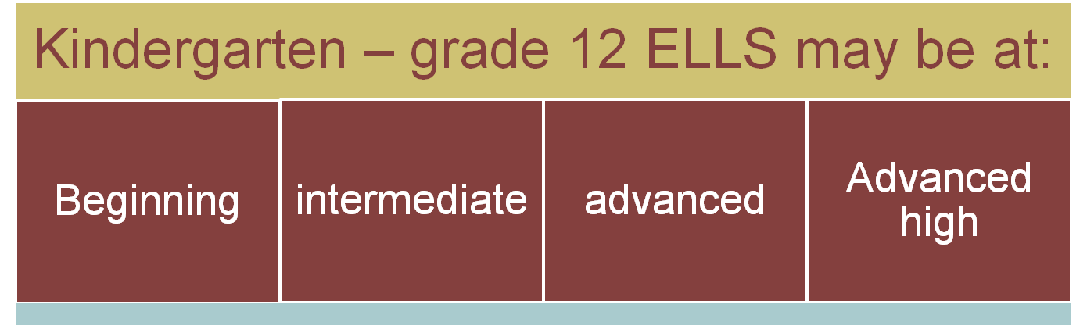
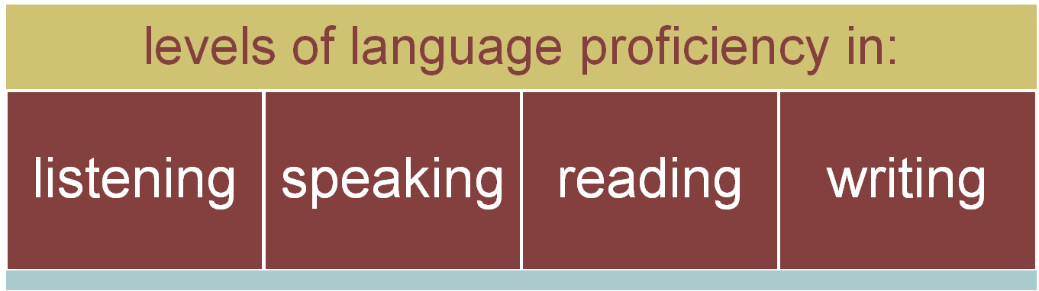
§74.4 ELPS (d)
Proficiency Level Descriptors
Notes:
Explain:
The development of language may be at different levels for different English language learners.
The TELPAS has proficiency level descriptors for each of the language domains(PLDs). They are the rubrics that raters use to determine student’s English language proficiency levels.
It is important that teachers who serve ELLs are familiar with the proficiency levels in order to effectively plan and deliver instruction.
This slide summarizes the major characteristics of the PLDs in terms of how well ELLs can understand and/or use English in social and academic settings at each of the four levels.

Slide 34
Using Language Proficiency Levels for Classroom Learning Interactions
Read-Reflect-Share
Now that you read page 14 and the first paragraph of page 15 on your own,
Reflect on the linguistic needs of beginning and intermediate students
Explain what is the purpose of this section of the ELPS Instructional Tool.
p. 14-15
Notes:
Once everybody worked together after they read pp. 14-15 of the Tool, ask them to share their conversation.
Say:
Now that you read and shared the key concepts, it is time to share within your groups.

Slide 35
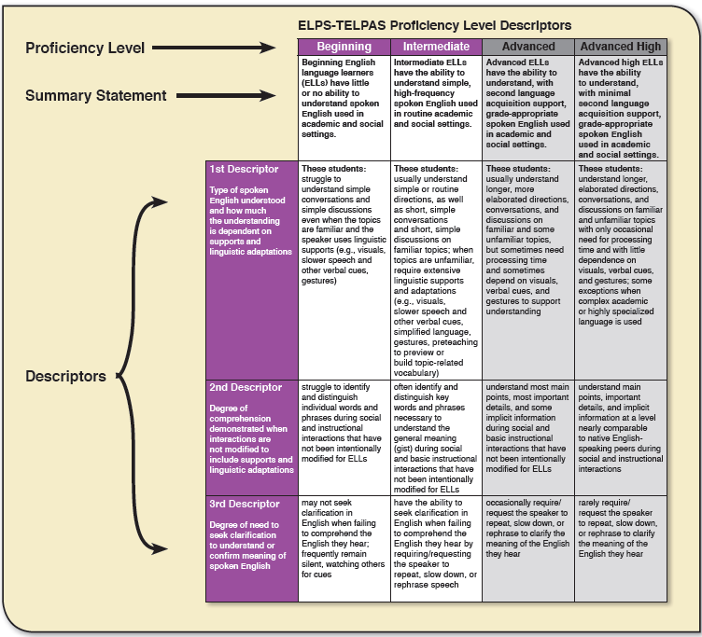
Understanding the ELPS-TELPAS Proficiency Level Descriptors
The descriptors in each column defines the summary statements and demonstrate what students know at each level of proficiency.
p. 15
Notes:
Refer participants to p. 15 of the Instructional Tool.
Language proficiency is the level of skills demonstrated when receiving messages (input) and expressing meaning (output). Students should be able to consistently and effectively demonstrate these skills across a variety of academic and social contexts.
Processing Activity: Have participants review the format of the organizer that outlines the descriptors.
Say: Each column defines the summary statements and demonstrates what students know at each level of proficiency for each of the language domains (Listening, Speaking, Reading and Writing).

Slide 36
ELPS-TELPAS PLDs
Read the information on p. 16.
Count-off 1-4. Assign a language domain p.17-20.
Each person will review the descriptors of their assigned language domain (listening, speaking, reading, and writing).
Create a T-Chart to compare and contrast all the descriptors of a beginning and intermediate student.
pp. 17-20
Notes:
Instructional Tool p. 17-20
Presenter will provide a T-chart.
Say:
We will review the descriptors in each column for the assigned language domains (listening, speaking, reading, and writing) to compare and contrast between what a beginning and intermediate students are able to do at each level.
Count-off from 1- 4. Each person will read the key features of his/her assigned language domain. (3 min). Use the T-Chart to write as you compare and contrast the descriptors of a beginning and intermediate student.
Divide participants in groups of 4. Assign-Jigsaw the language domains:
Participant #1-listening,
Participant #2-speaking,
Participant #3-reading,
Participant #4-writing.
SEE NEXT SLIDE

Slide 37
“Compare and Contrast”
T-Chart
Beginning
Intermediate
On our T-Chart, we are writing the ___ on one side. The other side has__.
p. 29
Listening
Speaking
Reading
Writing
Listening
Speaking
Reading
Writing
pp.17-20, 29
Notes:
Instructional Tool: Pp. 17-20, and 29
Compare and Contrast Processing activity:
After they reviewed the descriptors in each column for the language domain (listening, speaking, reading, and writing)
Lead the participants through the examination of some of the behaviors described on one of the student descriptors.
Ask participants to note the differences among the proficiency levels.
Now, direct them to p.29 to the “Compare and Contrast” three column chart. Ask them to find the column titled: “Present” and find the 4th bullet with the following sentence frame:
“On our T-Chart, we are writing the_____ on one side. The other side has ______ “. Participants will use it in a complete sentence to express what they did and why.
Next, they will use that sentence frame to compare and contrast between what a beginning and intermediate student is able to do at each level.
Participants can make their own chart or you can have it pre-printed from slide.

Slide 38
Planning Linguistically Accommodated Instruction Using the ELPS-TELPAS PLDs
Take into account the ELPS Cross-Curricular student expectations and the PLDs.
Choose appropriate lesson activities, supplementary materials and linguistic accommodations.
Familiarization with the PLDS allows educators to work efficiently within students’ current proficiency levels and assist students in developing the skills necessary to progress the next proficiency level.
Re-visit p.16
Notes:
Language development planning and content-based instruction involves an ongoing process in which teachers of ELLs must identify and respond to the linguistic and academic needs of individual ELLs.
The ELPS-TELPAS PLDs provide the guidance for educators to design and deliver grade-level, content-based instruction in conjunction with providing ELLs with a foundation in the English language.
Go over information on the chart: re-visit p.16 chart “Global definitions of the Proficiency Levels” and “Key features”.

Slide 39
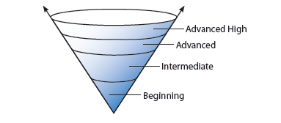
Degree of Linguistic Accommodations by Language Domain
p.21
Notes:
Direct participants to p. 21.
Explain: The cone-shaped model depicts the cumulative, spiraling, building nature of second language learning.
The body of language skills associated with a given stage of proficiency is prerequisite to the broader range of skills at the next stage.
The arrows indicates that language continues to develop beyond the advanced high level.
Source: TEA, Educator Guide to TELPAS, Grades K-12, Revised September 2011, page 10.

Slide 40
Jig-Saw Processing Activity
The next section provides an overview of the degree of linguistic accommodations by language domain.
The tables on p. 22-25 are color coded by language domain.
Work in groups of 4 and assign one of the language domains to each group member.
Each person will read and share the degree of linguistic accommodations for a Beginner or Intermediate student.
p. 22
Notes:
Instructional Tool p. 22
Say:
You will share what you learn with the people in your group until all of you are familiar with the all the key features of each language domain.
The focus is on beginning and intermediate linguistic accommodations in accordance to TAC 74.4(b)(4).

Slide 41
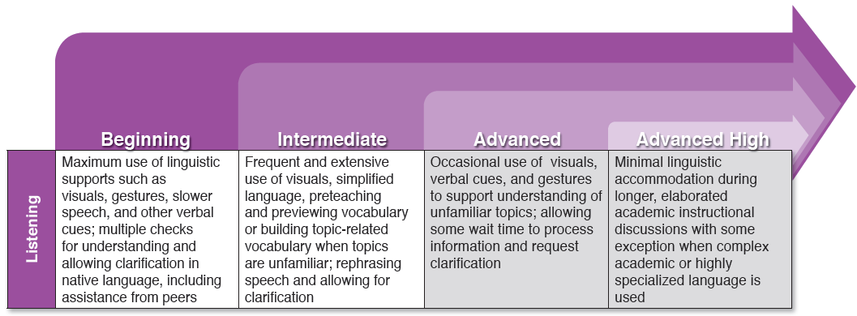
Degree of Linguistic Accommodations by Language Domain
Processing Activity
The level of linguistically-accommodated instruction decreases as students advance to higher levels of proficiency
p. 22
Notes:
Refer participants to their Tool p. 22
Review only the top sections of the pages that show the domain and the 4 levels of language proficiency.
Say: Although the color coded table on p. 22 include all four levels of language proficiency, the focus is on beginning and intermediate linguistic accommodations in accordance to TAC 74.4(b)(4).
Read this chart and compare the degrees of linguistic accommodations for a Beginner or Intermediate to an Advanced or Advanced High student. (Model how to review the Listening domain on the top chart of pp. 22)

Slide 42
Timed Turns: Comparing Degrees of Linguistic Accommodations
No one can talk for more than a minute. Have a Timekeeper on each group.
Take turns sharing the domain’s classroom activities, teacher supports, student outcomes, and teacher tips that can be used to help children move from simple to complex language.
Volunteers share what they learn about the “Teacher Tips” of each domain with our whole group.
Notes:
Read the types of
Compare the degrees of linguistic accommodations for a Beginner or Intermediate and find the differences. All of you will share what you learned with the people in your group.
Each person gets 22 seconds to share. Assign a time keeper in the group.

Slide 43
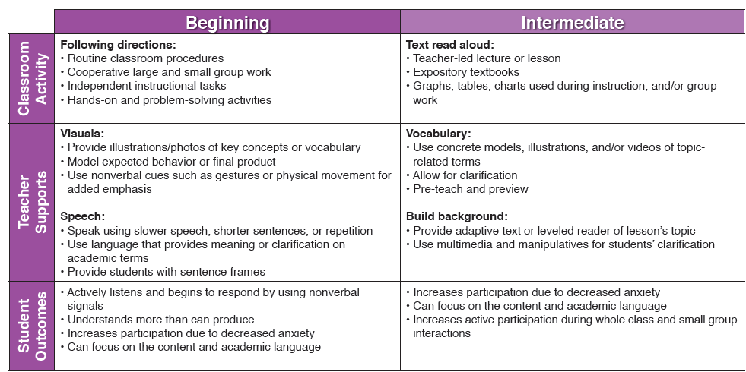
Degree of Linguistic Accommodations by Language Domain
pp 22-25
Notes:
Direct Participants to this chart on p. 22. This table provides an overview of the degree of linguistic accommodations for the Listening domain.
Jig-Saw Processing Activity: Assign the color coded language domains to one person per group (4 people per group). Participants will read their assigned color coded language domain.
Say: “Next, you will read the tables which shows the type of classroom activities, teacher supports, student outcomes, and teacher tips that can be used to help children move from simple to complex language.
Compare the degrees of linguistic accommodations for a Beginner or Intermediate and find the differences. All of you will share what you learned with the people in your group
Each person will get 22 sec. to share with their group what they learned. Assign a time keeper in the group.
You will share until all of you are familiar with the all the linguistic accommodations by language domains”.
Re-cap the Classroom Activity, Teacher Supports, and Student Outcomes for each of the language domains on pp.22-25. These are some examples of few ways teachers can adjust instruction.
Purpose: Become familiar with the all the key features of each language domain.

Slide 44
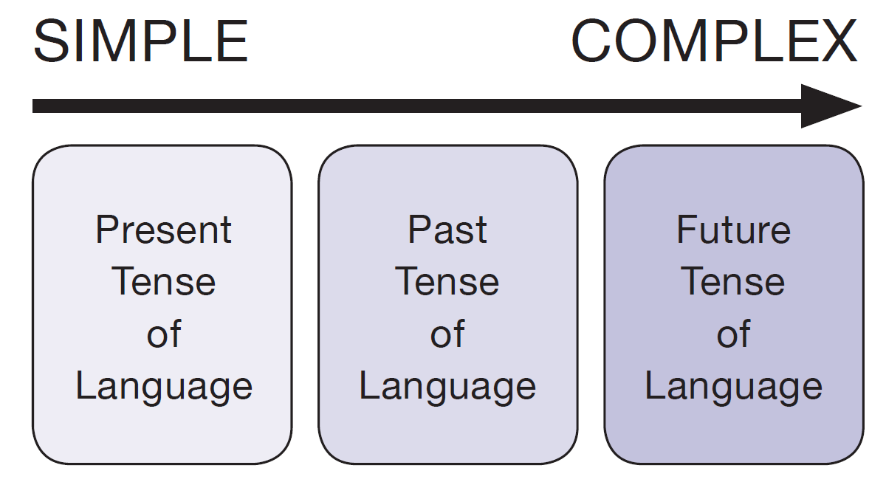
Linguistic Processing Skills
ELLs must be provided with multiple opportunities to employ a variety of grammatical structures
  some grammatical structures tend to be acquired more easily than others.
  progression is often simple to complex.
p. 26
Notes:
Instructional Tool p. 26.
Say: Please read this section and highlight the key concepts.
Examples of key terms: Probing questions, linguistic processing tools, acquire, attain. (Ask what is the difference between the last two terms).
Purpose: Demonstrate how ELLs students speak in present tense and move to the future tense.
Sentence stems help students develop language in all content areas.
Linguistic processing tools, such as sentence frames and probing question, can be adapted or scaffolded to support ELLs at varying levels of language.
Say:
Language development activities and student-learning tools need to be rooted in classroom instruction in order to support the transition from one level of language proficiency to the next. With time, ELLs will begin to acquire and attain the ability to apply these skills effectively in academic and social settings.

Slide 45
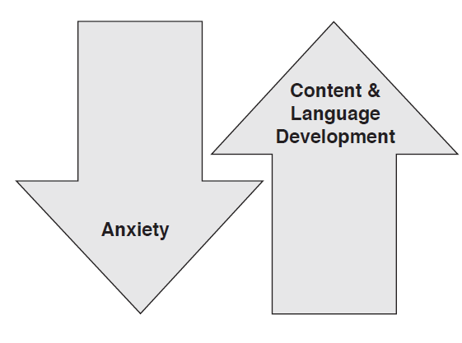
Linguistic Processing Skills
Sentence frames provide students with the means to receive and express language while reducing their anxiety.
Levels of content and language development will increase as students do not have to contend with context, grammar, and syntax simultaneously.
p. 27
Notes:
Instructional Tool pp. 27-33
The goal is to increase the linguistic complexity necessary for beginning and intermediate ELLs’ participation in listening, speaking, reading and writing activities.
Processing Activity: Direct participants to the bottom chart on p. 27.
Have participants select a theme/concept from the table.
Next, they will use pages 28-33 to go over the sentence frames.
Explain: These sentence frames can be used with instructional tasks or classroom activities that align with their specific themes/concepts.
These sentence frames can be used to develop probing questions.

Slide 46

Elements of Appropriate “Leveled” Questions
Provide cues and probing question that focus on what is important.
High cognitive questions result in deeper comprehension than low-cognitive level questions.
Pose a question and give time before you ask students to respond. It allows ELLs students to process their thoughts and increase student participation.
Probing questions are effective teaching tools when used with sentence stems.
Notes:
Recommended:
Use explicit cues when asking questions.
Ask questions that require inferences.
Ask high cognitive and “leveled” questions starting with “Tell me in your own words…” “Explain the…”, “Decide why…?”
Do not ask low level yes/no and either or questions, nor questions with one or two word answers.

Slide 47
“Leveled” Questions Samples by Language Proficiency levels
Level | Questions or Cues
Beginning | “Show me…” or “Which of these…?”
Intermediate | “Is it the ____ one or the ____one?” Questions that can be answered with one or two words
Advanced | “Did this happen at the beginning or at the end?” “What happened next?” Where did you find the answer?”
Advanced High | “How did you …?” “what was the character trying to do?”
Adapted from Krashen & Terrell, 1983.
Notes:
This is also a strategy called: “Leveled Questions”
Teachers must adjust their questioning (appropriate questions) so that the students can respond according to their language proficiency.
To level questions, you need to observe your student and know the English level at which the student interacts. This slide has suggestions on these hierarchical type of questions.
To level questions the teacher uses gestures and slows down the speech Source: Chap. 13, p. 75 in “50 strategies for Teaching English Language Learners” by Adriene Herrel and Michael Jordan.
See next slide: Steps to use “Leveled Questions” (based on the student’s language proficiency level)
Observe, document your student’s language levels
Choose, gather materials
Plan a hierarchy of questions

Slide 48
Steps to Create “Leveled Questions”
Observe, document your student’s language levels (keep updating).
Choose, gather materials: Visuals, artifacts help students demonstrate their understanding.
Plan a hierarchy of questions: Plan a series of appropriate questions at different levels to clarify concepts.
Notes:
This is also a strategy called: “Leveled Questions”. Source: Chap. 13, p. 75 in “50 strategies for Teaching English Language Learners” by Adriene Herrel and Michael Jordan.
Steps to use “Leveled Questions” (based on the student’s language proficiency level).
Observe, document your student’s language levels (keep updating).
Choose, gather materials: Visuals, artifacts help students demonstrate their understanding.
Plan a hierarchy of questions: Plan a series of appropriate questions at different levels to use them to prevent confusions.

Slide 49
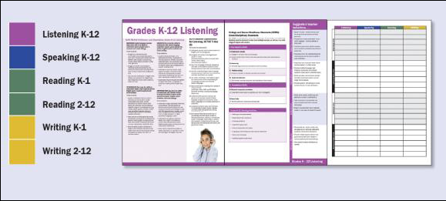
Steps to Create “Leveled Questions” (Cont.)
Involve all students: Use your list of students, TELPAS reports, and a chart like the one on the LIAG to plot names by proficiency levels to adapt/”level” your questions.
Assess student progress and understanding: Observe the student’s and document their periodic growth.
Notes:
Extra resource: Have a sample of the ELPS LIAG and a copy of the “ELPS Linguistic Instructional Alignment Guide worksheet”. Explain to participants where to find these items (It is part of another booklet: the ELPS Linguistic Instructional Alignment Guide (LIAG).
The chart with the student’s name list that appears on the last page of the LIAG. This power point includes a handout of the chart for this activity. See the last slides of this presentation. Copy the chart as a handout.
Objective: Participants will understand how to integrate their students lists and the PLDs to provide targeted second language Acquisition instruction, necessary to support content-based lessons and accelerate learning of English.
Say: These are the last steps to create “Leveled” Questions. Source: Chap. 13, p. 75 in “50 strategies for Teaching English Language Learners” by Adriene Herrel and Michael Jordan
Involve all students: Use your list of students, their TELPAS reports, and a chart like the one on the LIAG to plot their names according to their proficiency levels as a guide to linguistically adapt the levels of your questions to their individual language proficiency levels. Encourage participation.
Assess student progress and understanding: Observe the student’s responses each day and document their periodic growth. Use an anecdotal record to include it in the student’s portfolio.

Slide 50
Leveled Probing Questions
Use any lesson, an index card and the Instructional Tool. Now, let’s put the pieces together!
Select a sentence stem to create a probing question for a beginner or for an intermediate ELL student.
Write it on an index card, pose the probing question to your group, let somebody answer.
Explain why you think your question can promote language development.
Check each other’s sample questions to see if they match the appropriate proficiency level.
Notes:
Use any lesson activity that can promote Language Development. (Optional: Provide lessons by grade level in any content area such as “Conductors and insulators” p. 37 from Navigating the ELPS in the Science Classroom by J. Seidlitz). Have participants review the lesson with a partner.
Say: “Work in groups”
You will select a sentence frame from your tool to pose a “Probing” question for a beginner and an intermediate language proficiency level student.
Write the probing question on and index card.
Pose the question to your group, let them answer, after that, you will share your reasoning to create that specific leveled probing question. Take turns sharing everybody’s probing questions.
Time frame:(10 min).
Objective: Show participants how to use this tool and integrate it with other resources to provide focused instruction and develop academic questions that are specifically designed to support the needs of beginner and intermediate ELL’s students
Resources: Have a lesson plan sample. Index cards

Slide 51





How is Language Incorporated
Into Lesson Planning?
Language Focus
Plan Instruction
Strategies
Set Goals
Re-direct Purpose
Notes:
Ask: Why is it important to incorporate academic language objectives into your lessons?
Say: Because students who master academic language are more likely to succeed.
Re-direct your lessons with a “language focus”, then plan instruction and select specific strategies to meet the specific learning goals you set for your students.
Teachers need help in figuring out how to embed language objectives into a lesson. It is not easy to plan instruction with a language focus in mind.
Initially the emphasis has been on instructional strategies but researchers like Marzano, have found out that strategies alone were not enough, teachers need to re-design/re-direct their lessons with a language focus. Once this is done, teachers should select strategies to target the specific learning goals they set for their students.

Slide 52
ELPS Standards, the TEKS, and the TELPAS must align with grade level content standards and be based on “academic language”.
So…..
How Do We Plan Instruction?
Notes:
This tool was designed as a support tool mainly for beginner and intermediate language proficiency students. Think of it as your support to help students be engaged in the learning process. We have to create activities at the language level of the ELL. It is about changing the approach of the delivery more than about changing the content.

Slide 53
Instruction for English Language Learners
In Texas Schools
Curriculum
Standards
What to Teach
Research-based
ESL Methodology
How to Teach
Content
Language
Sheltered Instruction
Cognitive Academic Language
Others
TEKS
ELPS
Assessment:
STAAR
Assessment:
TELPAS
Learning Strategies
Modified from :What Every Secondary Content Area Teacher Needs to Know
Notes:
CURRICULAR CONECTIONS:
Explain the graphic organizer above, beginning with “Instruction for ELLs in Texas Schools”. All students, including LEP must have access to the TEKS. The TEKS provide teachers with “What to teach students” across the curriculum.
All ELLs should also receive appropriately modified instruction via research-based ESL Instruction and Sheltered Instruction methodologies that provide the “How to Teach” students.
This training is aligned to Sheltered Instruction Methodology.
Trainers can mention that there are other methods such as: CALLA (Cognitive Academic Language Learning Approach) by Chamot & O’Malley and The SIOP® Model.
TELPAS measures the ELPS student expectations from the cross-curricular second language acquisition knowledge and skills and uses the ELPS proficiency level descriptors as assessment rubrics.
Student expectations focus on the what of student learning. Proficiency level descriptors focus on the how well.

Slide 54
Formula for Writing Language Objectives
WHAT + DO + HOW
WHAT= What language skills should be taught to students within a lesson.
DO= What the student will do with the language (involves skills, grammatical structures, and language functions: explain, summarize, compare and contrast, describe, etc.).
HOW= How will the student demonstrate understanding of the content (label, draw, etc.).
Adapted from: “Strategies for ELLs in Secondary Science (Days 3 & 4), Texas Comprehensive Center at the Southwest Educational Development laboratory, April 11-13, 2007.
Notes:
Use handout from SEDL: Developing Language Objectives WHAT+DO+HOW
The following formula can help ensure the inclusion of language skills within any content lesson. Source: Southwestern Education Development Laboratory (SEDL), adapted from “Strategies for ELLs in Secondary Science”, binder #2. Chapter: academic Language Support for Limited LEP students, p.2. April 11-13, 2007.
WHAT- Language objectives
Statements that identify what language skills should be taught to students within a lesson.
2. Support school district and state content standards and learning outcomes
3. Guide instruction and learning in the classroom.
DO-What the students will do with the language, or what the language functions are.
1. Identify what students should be able to do using English (or another language) for reading, writing, speaking, and listening.
2. Support students language development by focusing on vocabulary, signal words(cause and effect, because, since, therefore, as a result, sequence, etc), questioning, articulating predictions or hypothesis, reading, writing and so forth.
HOW- How will the student demonstrate understanding of the content (completing tasks such as labeling, drawing).

Slide 55

In Formulating Objectives…
Each objective must contain an action verb.
It is best to have language objectives for lessons that address as many of the four language domains (listening, speaking, reading and writing) as possible.
Objectives must be measurable.
Research supports the value of teachers posting and explaining clear objectives so that students understand what is expected of them.
Notes:
Ask participant to respond to the following:
What is an action verb?
How can they be measurable?
Why should you post them?

Slide 56
Sorting Activity
Work in pairs
Take your envelope and use the T-Chart template to separate the content objectives and language objectives.
Discuss the differences between each of the examples and be ready to report to the whole group.
T-Chart
Notes:
Ask: Why are language objectives difficult to implement?
Say: Content teachers have difficulty identifying them:
Processing Activity: Categorize the objectives
Provide a plastic bag with the cards for each group. They will separate the sentence strips on the T-Chart provided.
Once all groups are done, show the answer key to let them know if their answer is correct or not.
Point out how this activity contains a content and language objective.
Why are language objectives difficult to implement?
Content area teachers do not have time to teach language
Teaching language has been the role of the ESL Teacher
In many instances content teachers do not know how to identify the different language level proficiencies in their students.

Slide 57

When Writing Content and Language Objectives…
Content Objectives: TEKS
Language Objectives: ELPS
Provide students with clear direction for what they need to learn/master.
Set learning goals. Encourages students to be responsible for their own learning, set goals and pace their learning.
Provide strategies/activities appropriate for the various English language proficiency levels.
Notes:
Content Objectives:
Participants will review background knowledge of why language objectives are an essential part of lesson delivery for Limited English Proficient (LEP) students.
Participants will be able to describe how language objectives differ from content objectives.
Optional Activity: (if time allows) Sorting Activity: T-Chart template and cards. Prepare: copy language objectives page, and cut to create a puzzle. Create cards for the puzzle.
Participants will orally discuss and categorize the cards with the content and language objectives.
Participants will create and write language objectives using TEKS Skills for a content area.
Participants will demonstrate their knowledge of language objectives by sharing with the group.

Slide 58

Language Objectives Can Focus on:
Vocabulary:
-Words, terms
Strategies for understanding.
Skill building: Reading, writing
Functional language.
How to ask questions, disagree, etc.
Relevant grammar.
Language that relates to higher order thought processes.

Slide 59
Examples of
Content and Language Objectives
Content Objective: Distinguish cause and effect in a story, text, newspapers.
Language Objective: The student will read the text provided while highlighting words that will help distinguish between cause and effect.
Sentence Stem: Select a sentence stem to explain the cause as well as the effects that are stated in some of the passages (select one from pp. 28-33).
Classroom Activity: (Select one from pp.22-25).
Notes:
Now you will provide another example that has the following:
Key Vocabulary: any key vocabulary related to the lesson/concept to be learned.
Content Objective: The student will demonstrate the comprehension of ___________.
Language Objective: The student will use _______________to distinguish the cause and the effect of ________.
Ask: What is the difference between both objectives?
Language Function: use language to compare, summarize, explain causes or effects, predict, etc. (Usage of English language)
Language Form: Grammar- superlatives, verb tenses, singular or plural nouns, sentence structure, etc.
Classroom Activities: Activities or strategies appropriate for the various English language proficiency levels.

Slide 60
Examples of Descriptive
Language Stems
The main idea of my concept map is …
The relationship between a ____ and a _____ is …
.
.
.
.
.
.
Navigating the ELPS in the Classroom, John Seidlitz & C. Araceli Avila, 2010.

Slide 61
Example
Content objective: The student will identify the properties of an atom 8.8B.
Language Objective: The student will know key vocabulary to discuss or write about atoms.
Language function: Summarize and paraphrase.
Language form: Use singular/plural nouns.
-Use sentence stems like: The number of ____affect the properties of the atom.
Activities or strategies: Students create a semantic feature map in their journals to demonstrate their understanding of the features of the parts of the atom.
Notes:
Purpose: Help teachers see the process of planning a lesson including the necessary elements.
Review the example.
Say: “Always remember to use the “WHAT+DO +HOW” formula.
1. Content Objective: The student will demonstrate the comprehension of the properties of atoms.
2. Language Objective: The student will use the language to____________ in summarizing________.
-Example of a sentence stem: “The number of protons affect the properties of the atom because…”.
-Language Function: Summarize and paraphrase the properties of various models of atoms, using plural and singular nouns. -Key Vocabulary: proton, atom, properties
-Mini-Language Lesson: Three to five minute lesson on nouns at appropriate time of lesson
Adapted from Hill, J. & Flynn, K.M. (2006). Classroom instruction that works with English language learners. Alexandria, VA: Association for Supervision and Curriculum Development, p.25.

Slide 62

Lesson Plan Activity
Notes:
Use a lesson from the “Navigating the ELPS in the …” content area books written by Jhon Seidlitz.

Slide 63
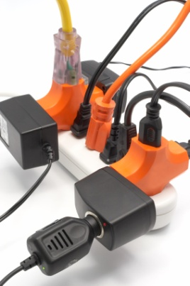
“Think-Pair-Share”
Steps to Integrate Language Objectives
Use the Linguistic Accommodations Planning Tool
ELPS Lesson Plan Example: Conductors and insulators.
In pairs, select a language proficiency level (beginner, or intermediate).
Review the lesson with a partner and select the lesson’s academic vocabulary (highlight it).
Notes:
Using the Linguistic Accommodations Planning Tool.
Provide p. 37 from “Navigating the ELPS in the Content………………….. By John Seidlitz, - ELPS Lesson Plan Sample on Conductors vs. Insulators. Each group of teachers will complete/fill in the lesson.
Say:
Choose a proficiency level (Beginning or Intermediate).
Develop a Language Objective.

Slide 64
Degrees of Linguistic Accommodations in Planning Instruction
Use the Linguistic Accommodations Planning Tool
ELPS Lesson Plan Example: Conductors and insulators.
Write four accommodations to support a Beginning or Intermediate student
Use your tool to select examples of classroom activities and teacher support pp.22-25.
Share out.
Notes:
Use the same lesson on Conductors vs. Insulators.
Say:
Use pp. 22-25 of the ELPS Instructional Tool to select examples of classroom activities and teacher supports.
Use them to write four accommodations to support a Beginning or Intermediate level student using the PLDs found on pp 17-20.
Share out.

Slide 65
“Think-Pair-Share”
Steps to Integrate Language Objectives
Based on WHAT the content objective is, determine what language will the student need to discuss, read, or write about the topic. Use the ELPS, and write a language objective.
In pairs, use the lesson to identify what students will DO with the language skills and grammatical structures.
Adapted from: “Strategies for ELLs in Secondary Science (Days 3&4), Texas Comprehensive Center at the Southwest Educational Development laboratory, April 11-13, 2007.
Notes:
WHAT + DO + HOW
Provide a copy of the ELPS student expectations
Review what a language function and a language structure is.
Say: You will use the ELPS to select a language domain and identify a language skill (ELP) which you will use to develop a language objective.
Processing Activity: What steps do I need to take?
Use the ELPS to write a language objective (the WHAT) to target one or more language needs of a beginner or an intermediate student.
Use the “Developing Language Objectives: WHAT + DO + HOW” page from: “Strategies for ELLs in Secondary Science” (Days 3 & 4), Texas Comprehensive Center at the Southwest Educational Development laboratory (SEDL), April 11-13, 2007.

Slide 66
“Think-Pair-Write”
5. Write HOW will students demonstrate their understanding of the content, and what language will be embedded in the assignment?
* What other materials/resources will make content comprehensible for your ELL students?
6. Find a partner from another table and share.
Adapted from: “Strategies for ELLs in Secondary Science (Days 3&4), Texas Comprehensive Center at the Southwest Educational Development laboratory, April 11-13, 2007.
Notes:
Materials:
Any lesson sample.
Discuss with a partner: Are the Content Objectives (TEKS) and the Language Objectives (ELPS) focused/specific for my selected language proficiency level?
Are the objectives written at the appropriate student’s language proficiency level?

Slide 67

Remember: Language Objectives…
Are Posted for students to see and refer back to.
Are dictated by the content of the lesson:
  What do students need to do with language in order to achieve the content objectives?
  What opportunities for language development exist within the lesson?
Notes:
Show samples of this.
Say: Set the objectives and post them where they are visible for the students. Explain these to the students

Slide 68


Inside-Outside
Points to Remember
Notes:
Copy all 7 slides on “Points to remember” and laminate them to use them for an activity (Next slides) .
Processing activity to learn definitions or concepts: “Inside-Outside” Circle.
Give the 7 slides to a group of 7 participants, they will be in the inside circle, have at least 14 people in the outside circle rotating to hear the Points to remember. Once they are done, ask the participants in the inside circle to trade places with somebody in the outside circle.

Slide 69

Points to Remember
When Writing Language Objectives
Determine key technical vocabulary, concepts words, and other words needed to read or write about the topic of the lesson (e.g., names of important people and places, processes, concepts, content specific, specialized terms).
Notes:
Processing activity to learn definitions or concepts: “Inside-Outside” Circle.

Slide 70

Points to Remember
When Writing Language Objectives
2. Consider the language functions students will use in the lesson (e.g., Will they define terms, describe or explain, classify, compare, or summarize?) and teach/reinforce the function within the lesson activities.
Notes:
Processing activity to learn definitions or concepts: “Inside-Outside” Circle.

Slide 71

Points to Remember
When Writing Language Objectives
Decide which language skills are needed to accomplish the activities in the lesson and provide explicit instruction in the skills. Do students have to read for main idea? Are they asked to listen and give an opinion? Will they edit sentences or essays about the topic?
Notes:
Processing activity to learn definitions or concepts: “Inside-Outside” Circle.

Slide 72

Points to Remember
When Writing Language Objectives
4. Identify possible grammar or language structure connections (e.g., questioning patterns, sentence structure, paragraph writing, punctuation practice, use of past or future tense, pronoun usage).
Notes:
Processing activity to learn definitions or concepts: “Inside-Outside” Circle.

Slide 73

Points to Remember
When Writing Language Objectives
Consider the tasks students need to complete and determine what language might be embedded in the assignments that could be pulled and turned into explicit instruction in language (e.g., students negotiate roles, students read and take notes, one student explains a procedure to another).
Notes:
Processing activity to learn definitions or concepts: “Inside-Outside” Circle.

Slide 74

Points to Remember
When Writing Language Objectives
6. Explore possible language learning strategies to share in the lesson (e.g., language of prediction or hypothesis, use of cognates, preview of text via illustration and bold print, note taking).
Notes:
Processing activity to learn definitions or concepts: “Inside-Outside” Circle.

Slide 75

Points to Remember
When Writing Language Objectives
7. Integrate the English Language Proficiency Standards (ELPS) by first analyzing the content, concepts, process, and skills of the lesson and determining what type of language development is a natural fit that will at once increase comprehension of instruction (content, concepts. etc.) and develop language proficiency.
Notes:
Processing activity to learn definitions or concepts: “Inside-Outside” Circle.

Slide 76

Did We Meet Our Goals?
  Content Objective – Participants will explore how to plan effective instruction that addresses the language development process of ELLs identified at the beginning and intermediate proficiency levels in grade 3 or higher.
  Language Objective – Participants will discuss how to design instruction to provide an intensive and ongoing foundation in second
  language acquisition.
Notes:
To conclude the session, review training goals with participants emphasizing the importance of having objectives reviewed at the end of each lesson to recap the objectives of the lesson or instruction.
Remind participants that Content objectives describe what content will be learned, while Language Objectives describe how the content will learned.

Slide 77
3-2-1 Reflection
Think-Write-Share-Pair
Think and write on post-it notes
3 new ideas I learned about language objectives are_______________.
2 ways I am going to use the ideas learned in this session are______ and______.
1 question I still have about ______ is____.
Share with a partner.
Notes:
Share with your campus group these reflections.
Goal:
To conduct a framed oral recap
Processes:
Read the slide to the participants.
Have participants use the stem to share with a partner.
Have participants write their responses on a post-it note and put them on the door when leaving.

Slide 78

You made it! YEAHH!
Your feedback is important to us! Please evaluate this training online.
The system will generate your certificate.

Slide 79
Contact Information:
Karina Chapa
Director - Language Proficiency, Biliteracy, and Cultural Diversity
kchapa@esc1.net
956-984-6246
Perla Roerig
Bilingual/ESL Specialist
proerig@esc1.net
956- 984-6238

Slide 80
Use next slides as handouts
Notes:
Tabs
Sticky notes to tab pages in the tool
Chart tablet
Copy and cut the puzzle
Print 20 dice on index paper, cut and glue, 1-2 per group
Prepare cards/envelops to cut and separate content and language objectives on a T-Chart.
Create/Print a T-Chart
Print page wit ELPS section C
Have newspapers or story books 2 per table

Slide 81
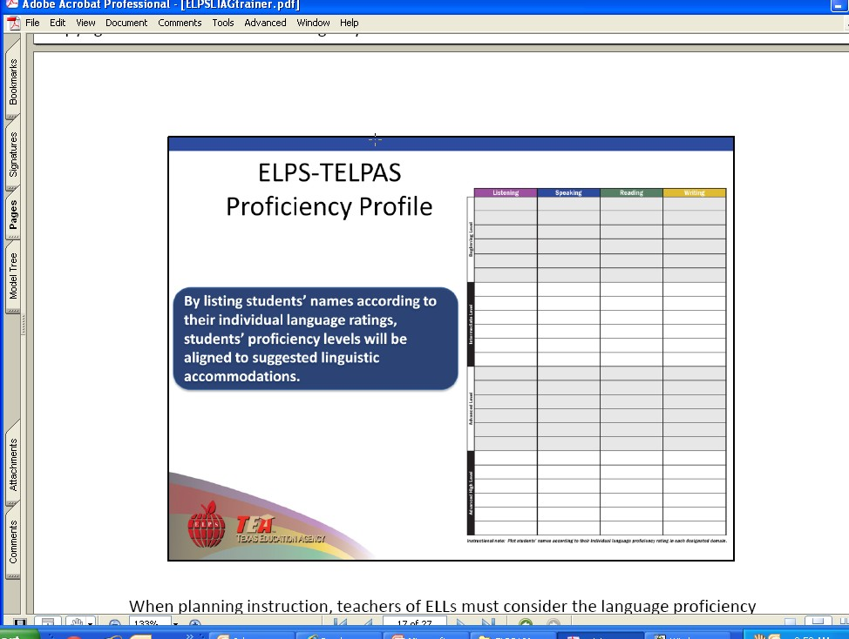
Student 1
Notes:
Use this last slide as a Handout for the activity on slide # ELPS … a Framework

Slide 82
Write What Should Be in Each Quadrant
A. Introduction | B. School District Responsibilities
Cross-Curricular Second Language Acquisition Knowledge and Skills (SE) | D. Proficiency Level Descriptors
§74.4 ELPS.
Notes:
Use this last slide as a Handout for the activity on slide # 8 ELPS … a Framework

